Slide 1

Project on
“Job Role Prediction”
For the subject term work submission of
Major Project II
By
1.Juhi Checker (Roll No. 7920)
2.Sayali Deo (Roll No.7926)
3.Anne Rajan (Roll No.8160)
BE.(Computer Engineering)
Semester VIII for ACADEMIC YEAR 2019-20
Under Guidance of
Dr. Brijmohan Daga
Department Of Computer Engineering
Fr. Conceicao Rodrigues College of Engineering
Fr. Agnel Ashram, Bandstand, Bandra (W). Mumbai 400 050. MH. IN

Slide 2
Literature Review
Career goal specially choosing the appropriate career through monitoring of the scope and trends in computer science and engineering job dimension have been a prime need for all computer science undergraduate youngsters. It has always been essential for an early signal to help the developmental mindset. The papers have made an attempt to explore dynamic data set and apply data mining based methods to explore student’s insights based on characteristics related to academic, technical and interpersonal factors.
In the following papers have used machine learning techniques such as SVM, Decision tree, Random forest, KNN, Naive Bayes algorithms. Amongst these algorithm SVM is proven to give the best accuracy. These algorithm have been trained on a small dataset with few class divisions. Features like gender, sector, reservation, rank, student initial condition, age, educational level of parents, emotional factors, instructor difficulty, problem solving skill, professional skill, enthusiasm, final year project type,teamwork ability, communication skill, research background, strength, attitude, discipline, social ability, adaptability, leadership, team work, career.

Slide 3
Motivation
The awareness of choosing the right option for career is increasing among the students. The students fail to know their strengths and choose career randomly which leads to frustration and demoralization. The automated systems is used to evaluate the personality traits of the individual and predict which field would be best suited for them. The accuracy of prediction depends on the set of relevant skill parameters and analytics on these. The research in view to design the accurate prediction and recommendation systems shows Artificial Neural Network.

Slide 4
Abstract
There is a trend amongst students to generally opt for career paths based on either the choices of their colleagues or the highest salary paying roles. They fail to know their strengths and choose their career randomly which leads to frustration and demoralization. Moreover, while recruiting the candidates, recruiters need to assess them in all different aspects. Thus, there is a need for a system that helps students decide a job role that is best suited for him/her which is based on his/her skillset and other evaluation metrics which is now possible due to advancements in the field of deep learning. We propose an automated system using Artificial Neural Network which considers personality traits of the individual along with personal interests and academics to predict which computer science job role would be best suited for them.

Slide 5
Objective
As students are going through their academics and pursuing their interested courses, it is very important for them to assess their capabilities and identify their interests so that they will get to know in which career area their interests and capabilities are going to put them in. This will help them in improving their performance and motivating their interests so that they will be directed towards their targeted career and get settled in that. Also recruiters while recruiting the candidates after assessing them in all different aspects, these kind of career recommender systems help them in deciding in which job role the candidate should be kept in based on his/her performance and other evaluations.

Slide 6
Scope
When one decides a career, this choice can shape ones life entirely. Recently, more and more people have begun to re-evaluate their career decisions and change careers at a later stage in life. This can be prevented by proper counselling of young teenagers before they begin their graduate studies. To solve this problem, data of students is used, where the personalities, aptitude and student general information is mapped with their careers. The Job-Role Prediction System uses a variety of questions that students have to answer to test their aptitude as well as students background questions. The students personalities are determined using their extra-curricular activities. The answers are then entered into the created model to predict the career that matches the students aptitude and personality.

Slide 7
Applications and Existing system
In research paper, models such as SVM, KNN, Naive Bayes, Decision tree and Random forest algorithm are used. There are no proper applications available to predict which job profile the person would be fit based on different criterias in the area of computer science and engineering.

Slide 8
Input Parameters
No. | Name | Type
1. | Percentage Operating Systems Algorithms Programming Concepts Software Engineering Computer Networks Mathematics Communication Skills | Academics
2. | Hackathons | Co-Curricular
3. | Certifications App Development FullStack Development Hadoop Information Security Machine Learning Python Shell Programming | Co-Curricular
No. | Name | Type
4. | Interests Analyst Management Programming Cloud Computing Data Engineer Software Engineering System Developer Hacking Networks Security Web Development | Co-Curricular
5. | Team-spirit (sports) | Extra-Curricular
6. | Leadership Ability | Personality
7. | Introvert/ Extrovert | Personality
8. | Self Learning capability | Personality
9. | Management/Technical | Personality

Slide 9
output Parameters
No. | Job Profile
1 | Business Analyst
2 | Database Administrator
3 | Project Manager
4 | Security Administrator
5 | Software Developer
6 | Technical Support

Slide 10
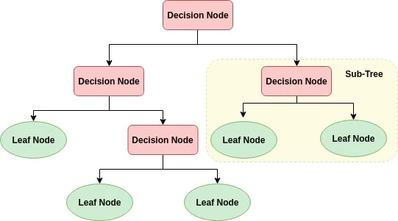
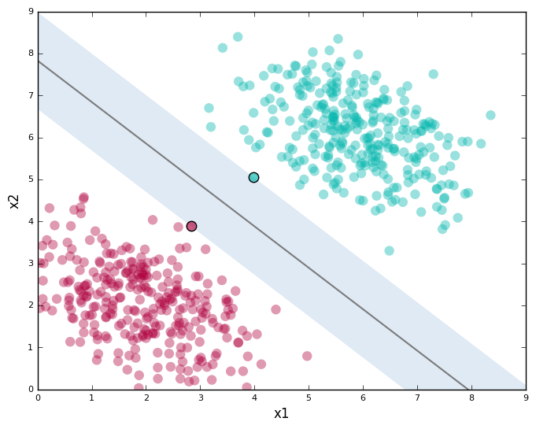
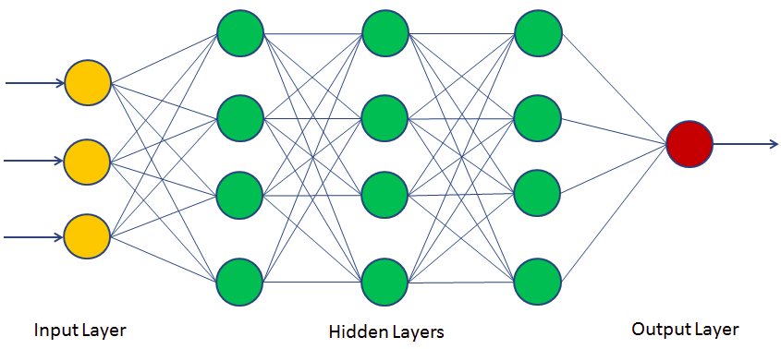
Proposed Architecture
Decision Tree
Artificial Neural Network
SVM

Slide 11
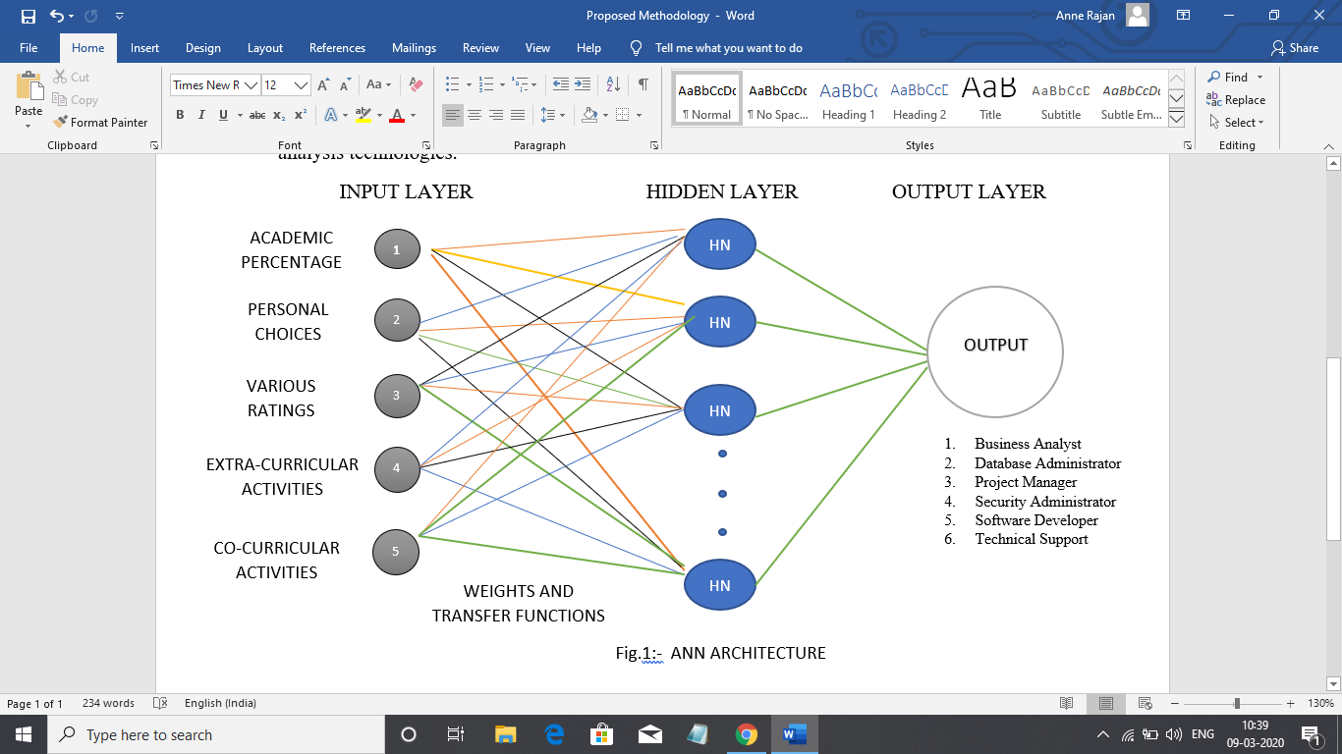
Proposed Architecture
The proposed ANN model consists of an input layer, 10 hidden layers and an output layer which uses a Sequential model.
The input layer is given inputs such as academic percentages, extra & co-curricular activities, various activities and personal choices i.e 15 input features. There are 20 nodes in total which take input and using activation function give the output to the next layer. Rectified linear unit(ReLu) function was used instead of sigmoid and tanh function since it gave better accuracy and was less expensive operation than the other two. Further, L1 regularizer was used instead of L2 as it was shrinking the less important features coefficient to zero.
The 2nd layer consisted of 20 nodes which take input from the first layer. The ReLu function was used in this layer just like the first layer. The next 9 layers are the same as the 2nd layer leaving the fact that it receives the input from its previous layer.
The last layer consists of 6 outputs because the model predicts one of the 6 domains due to which the model uses multiclass classification in the last layer. Softmax activation function was used in the model for multiclass classification which gave fairly good results. To select a particular domain the model sets probability to each class so that it can select the class with maximum probability, it is done using a categorical cross entropy.

Slide 12
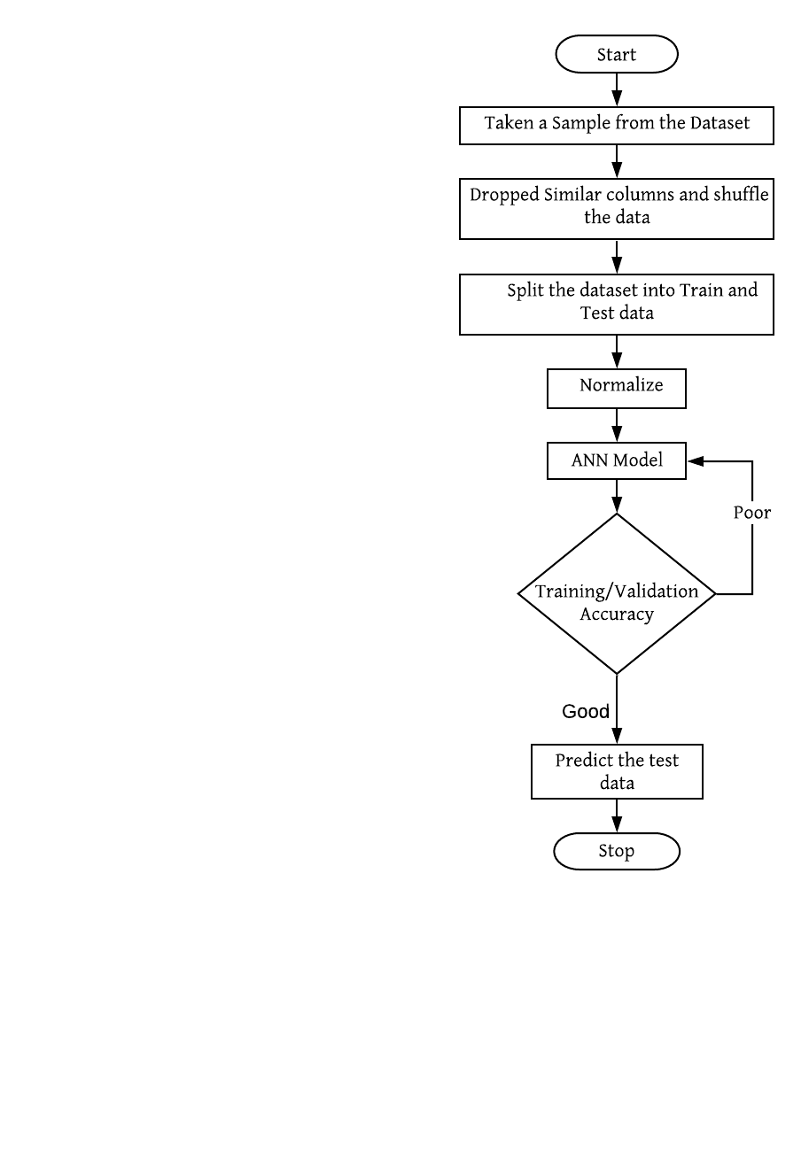
Algorithm
Methodology
TRaining parameter
Parameter | Symbol | Value
Learning Rate | ɑ | 0.0001
Exponential decay rate for moment | _{β1} _{β2} | 0.9 0.999
Epsilon | ε | 10⁻⁸
Epochs | - | 1000
Minibatch Size | - | 512

Slide 13
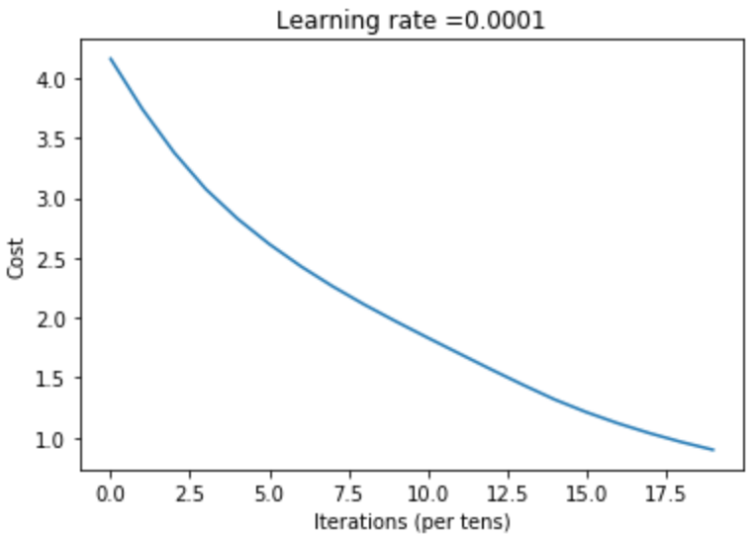
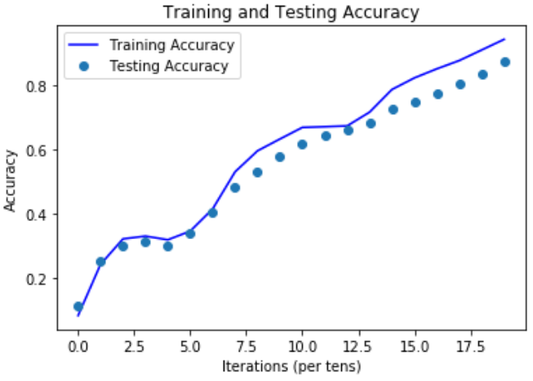
Result
The proposed Recommender System is being trained on 18,000 datasets having 15 parameters which gives an accuracy of 99% whereas testing on 3,000 datasets with same parameters gave an accuracy of 94.9%. In comparison with Roy, K. et al. (2018) [10] model who used traditional machine learning algorithms like SVM, XGBoost and Decision our model proved to give better accuracy than theirs.

Slide 14
Conclusion
The developed model is apt for the analysis of many objective factors for a person with qualified knowledge, and skills. This recommender system can be used by any IT based recruiter to hire a candidate appropriate for the job. Additionally, an individual as a Computer Engineering fresher can find out the domain that they are qualified for based on their profile and the ones who are unaware of their career. The proposed model used 15 parameters to predict one of the six job-roles with an accuracy of 94.9%. Hence, ANN model gives more accurate results to traditional machine learning models.

Slide 15
FUTURE WORKS
A. Sub-Domains - The model can be further scaled to recognize the specialization within that particular domain. For instance, if the suggested role is in the domain of Security, there can be various sub domains within it like System Security Administrator, network Engineer, Network Administrator, Information Security Analyst, etc.
B. Scalability - The dataset has been trained on only computer engineering fields. The model can be scaled to perform for various other fields of education eg: Commerce, Arts and so on.

Slide 16
References
S. Elayidom, S. M. Idikkula, J. Alexander and A. Ojha, "Applying Data Mining Techniques for Placement Chance Prediction," 2009 International Conference on Advances in Computing, Control, and Telecommunication Technologies, Trivandrum, Kerala, 2009, pp. 669-671.
A. Slim, G. L. Heileman, J. Kozlick and C. T. Abdallah, "Employing Markov Networks on Curriculum Graphs to Predict Student Performance," 2014 13th International Conference on Machine Learning and Applications, Detroit, MI, 2014, pp. 415-418
R. H. Rangnekar, K. P. Suratwala, S. Krishna and S. Dhage, "Career Prediction Model Using Data Mining and Linear Classification," 2018 Fourth International Conference on Computing Communication Control and Automation (ICCUBEA), Pune, India, 2018, pp. 1-6.
Arafath, Yeasin & Saifuzzaman, Mohd & Ahmed, Sumaiya & Hossain, Syed. (2018). Predicting Career Using Data Mining. 10.1109/GUCON.2018.8674995.
L. S. Katore, B. S. Ratnaparkhi and J. S. Umale, "Novel professional career prediction and recommendation method for individual through analytics on personal traits using C4.5 algorithm," 2015 Global Conference on Communication Technologies (GCCT), Thuckalay, 2015, pp. 503-506.
Uddin, Muhammad & Lee, Jeongkyu. (2016). Predicting good fit students by correlating relevant personality traits with academic/career data. 968-975. 10.1109/ASONAM.2016.7752357.

Slide 17
References
R. E. Uhrig, "Introduction to artificial neural networks," Proceedings of IECON '95 - 21st Annual Conference on IEEE Industrial Electronics, Orlando, FL, USA, 1995, pp. 33-37 vol.1.
Bao, Xuecai & Wang, Tangsheng & Hu, Jianfeng. (2009). “Analysis of Individual Career Decision-Making Based on Partial Least-Squares Regression Model”. 6th International Conference on Fuzzy Systems and Knowledge Discovery, FSKD 2009. 2. 522-526. 10.1109/FSKD.2009.192.
X. Bao, T. Wang and J. Hu, "Analysis of Individual Career Decision-Making Based on Partial LeastSquares Regression Model," 2009 Sixth International Conference on Fuzzy Systems and Knowledge Discovery, Tianjin, 2009, pp. 522-526.
Arafath, Yeasin & Saifuzzaman, Mohd & Ahmed, Sumaiya & Hossain, Syed. (2018). Predicting Career Using Data Mining. 10.1109/GUCON.2018.8674995.
L. S. Katore, B. S. Ratnaparkhi and J. S. Umale, "Novel professional career prediction and recommendation method for individual through analytics on personal traits using C4.5 algorithm," 2015 Global Conference on Communication Te
[2] [3] [4]

